Slide 1
Predicting resignation rates in the ICT industry and trend analysis for ICT higher education intakes
Muhammad Iylia
P7474841

Slide 2
Datasets
Job Vacancy Rates
Recruitment Rates
Resignation Rates
Paid Overtime Hours
Total Paid Hours
Incidence of Retrenchment
Polytechnic Intake
University Intake

Slide 3
Datasets
Filtered to Information, Communications and Technology industry data
Data with quarter column was split into year and quarter columns using pd.str.split()
Data was merged using inner join by year and/or quarter columns using pd.join()
‘-’ values were converted to 0

Slide 4
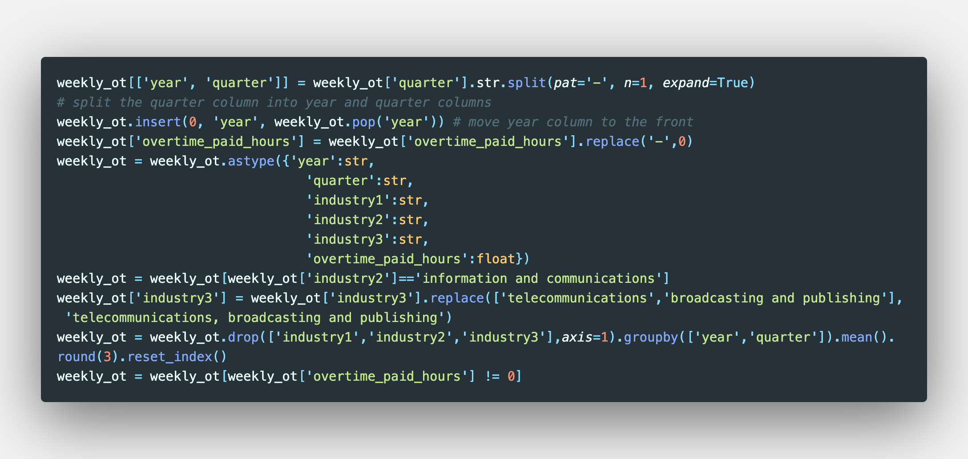
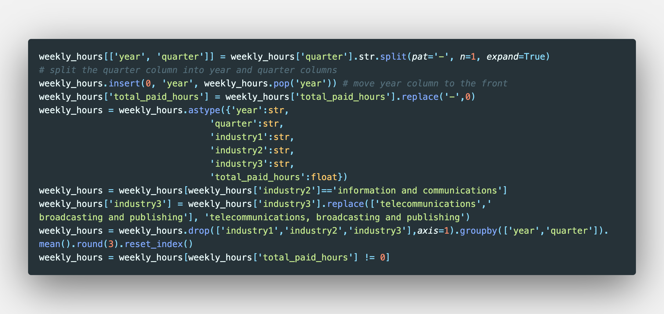
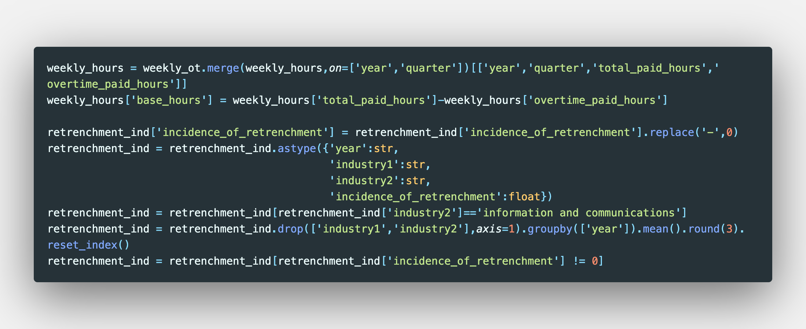
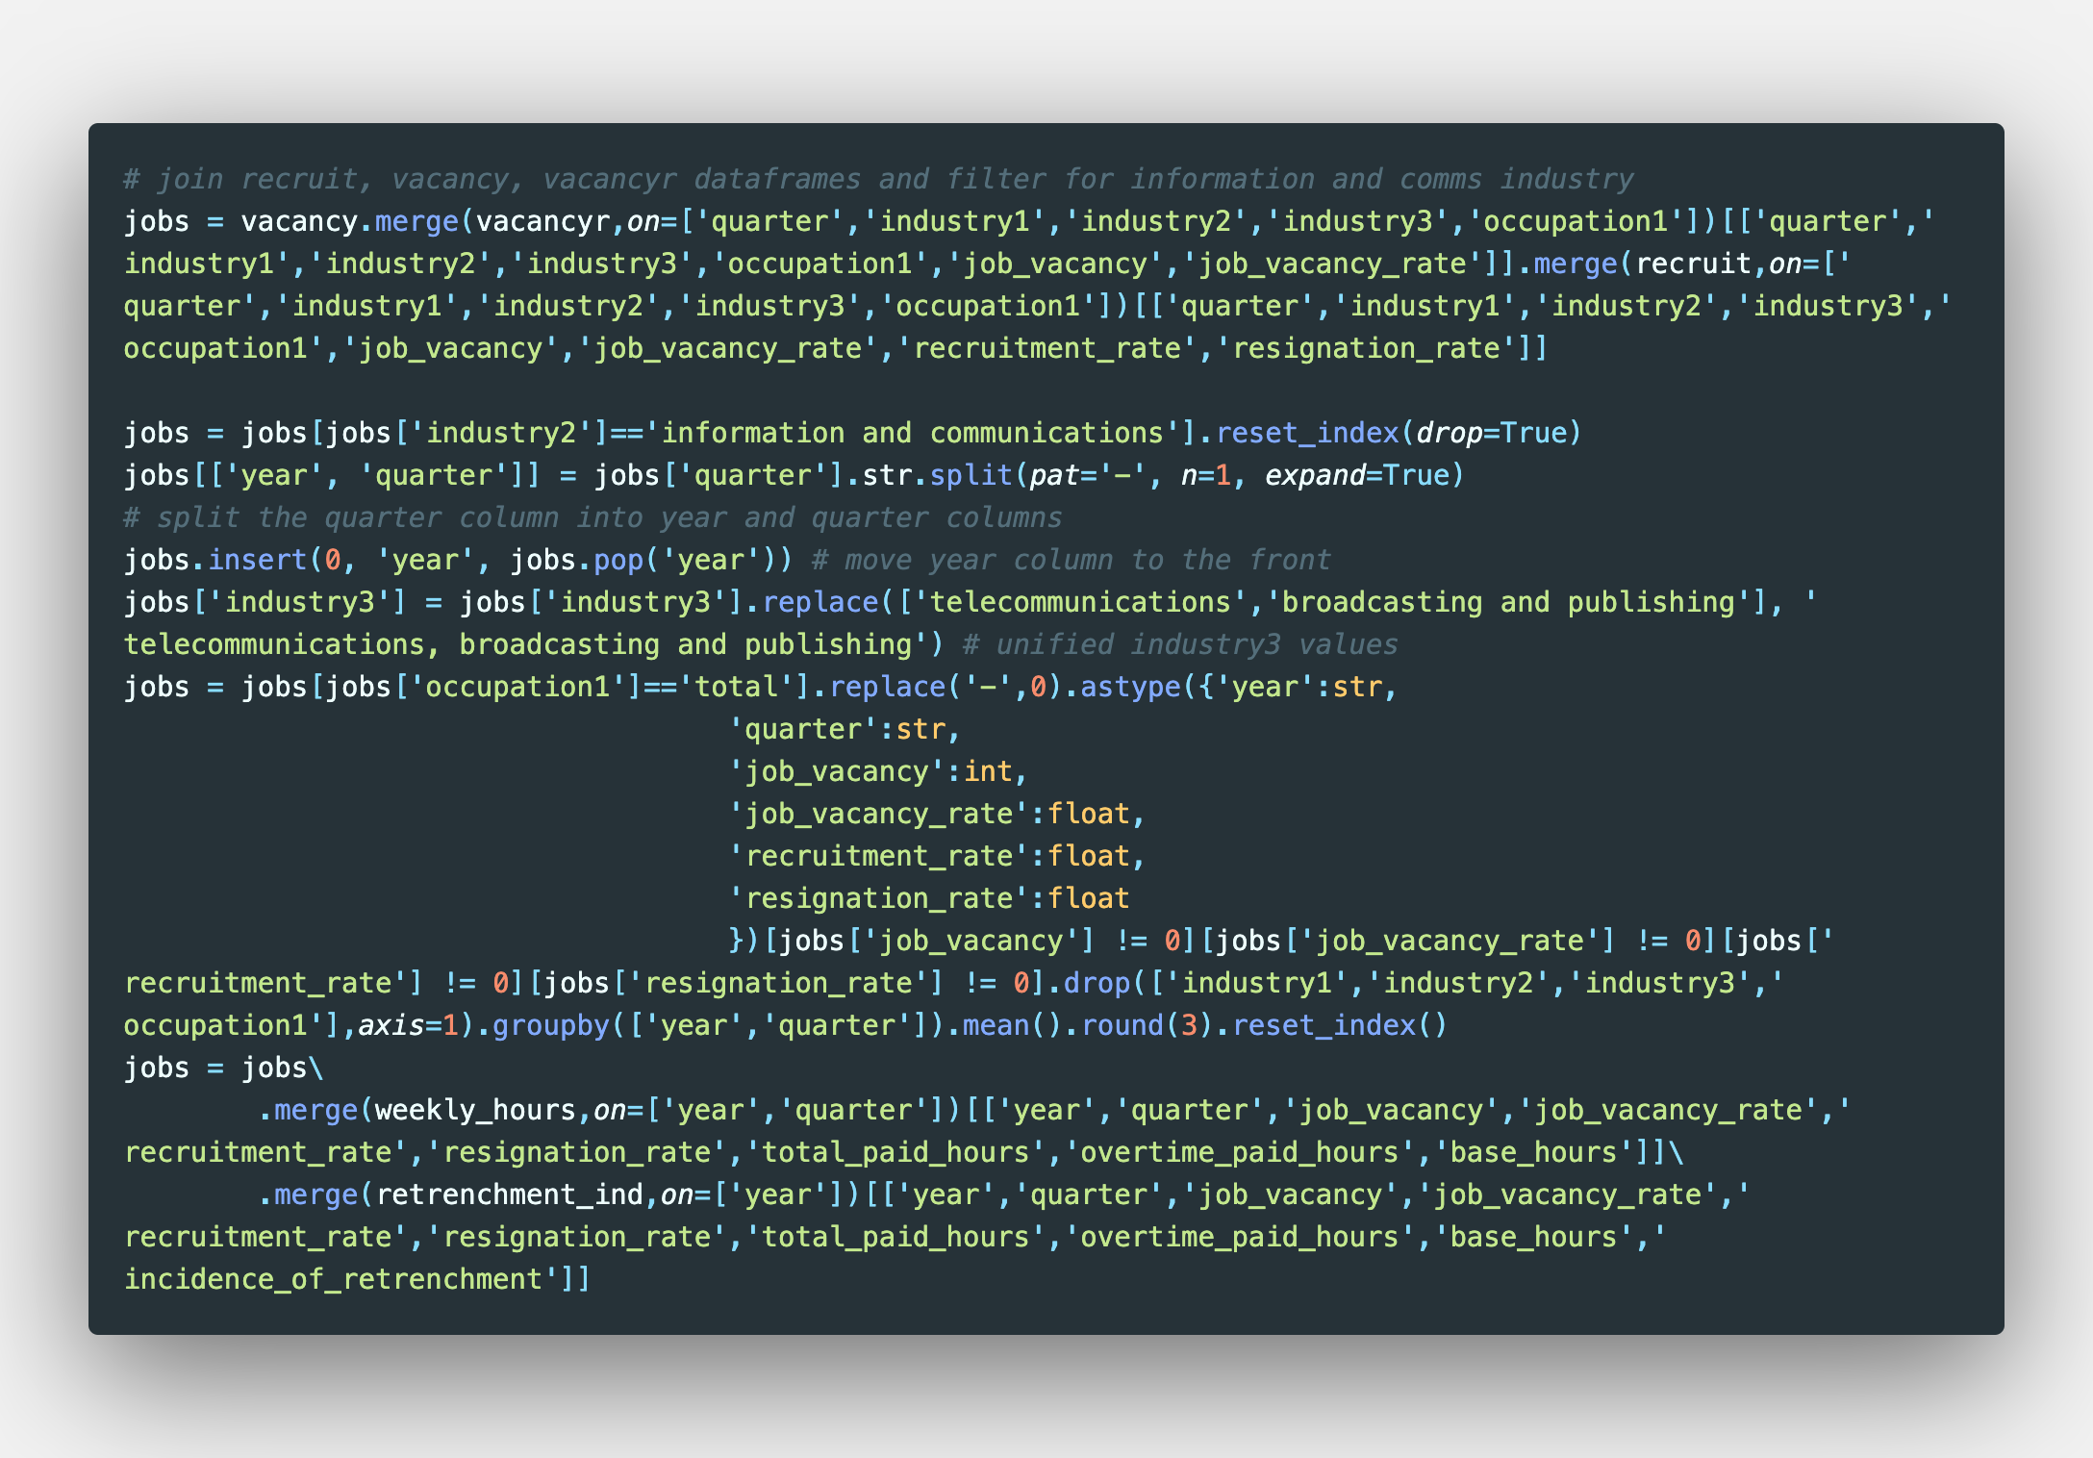
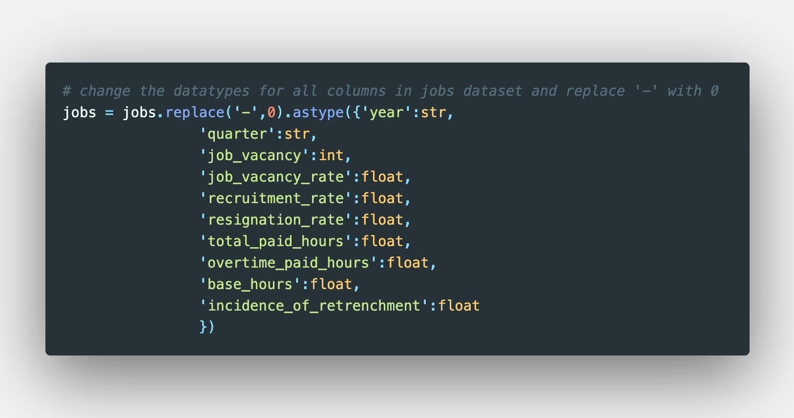
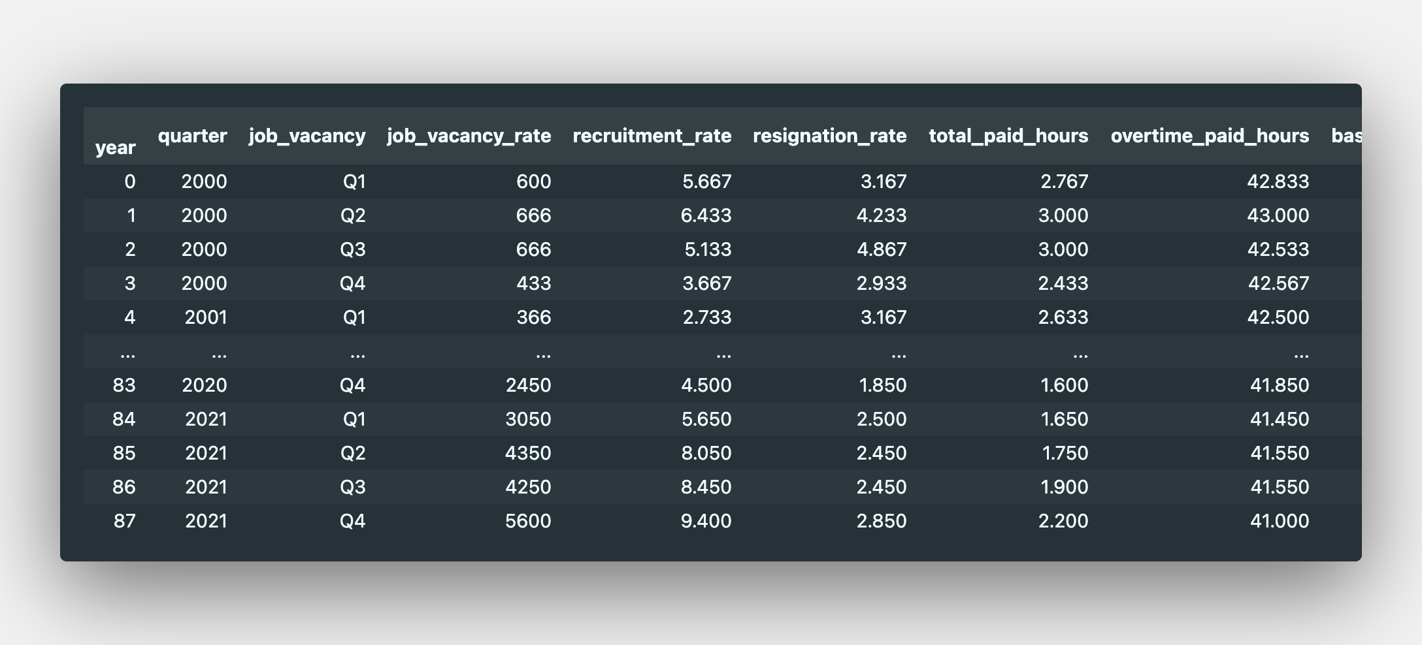
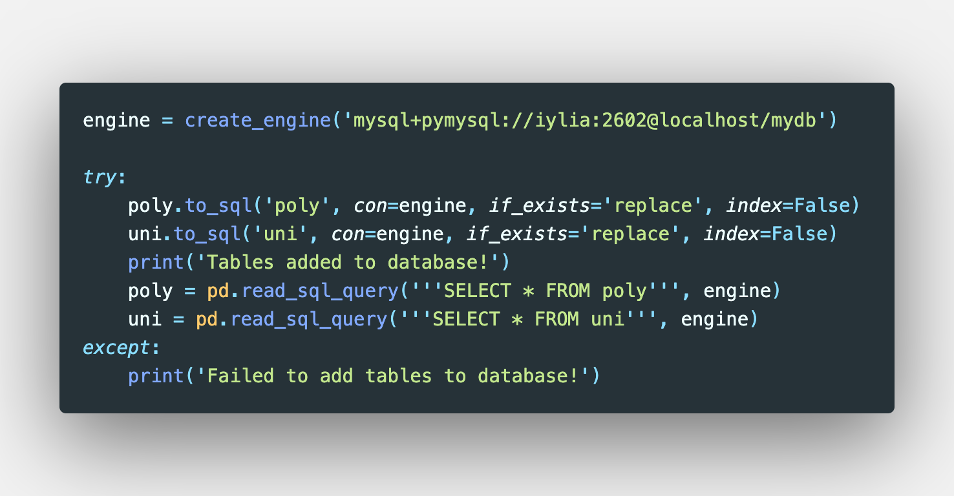
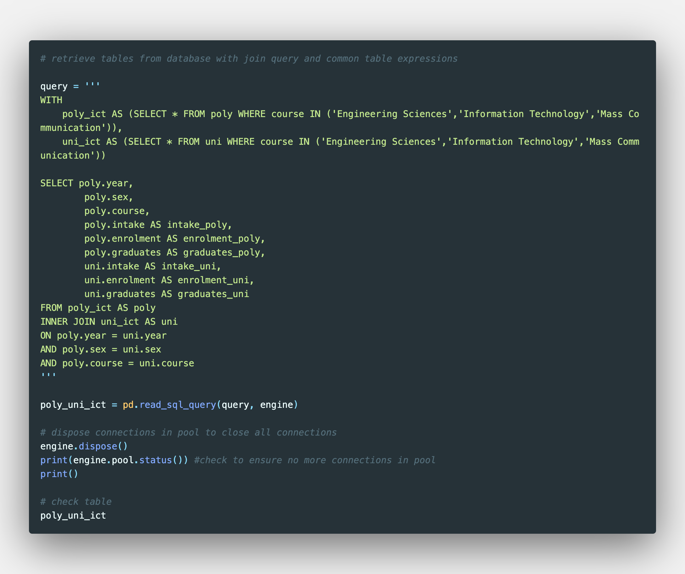
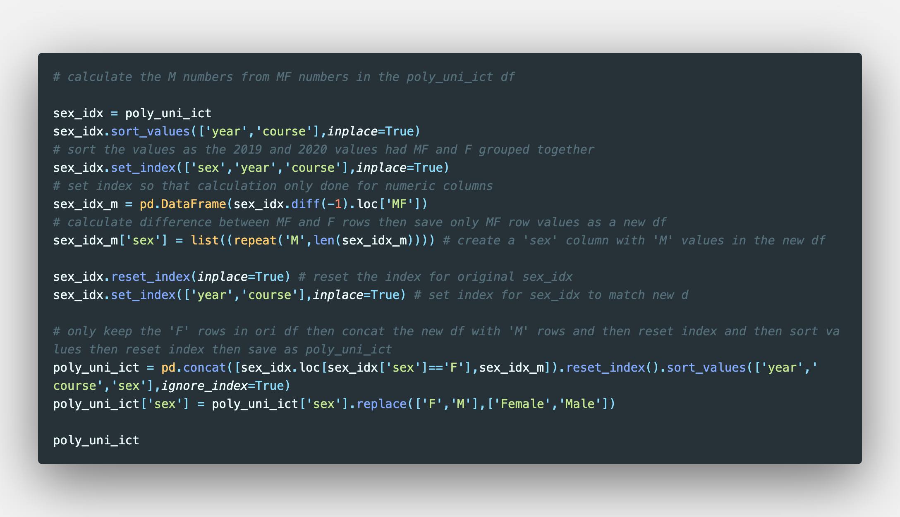
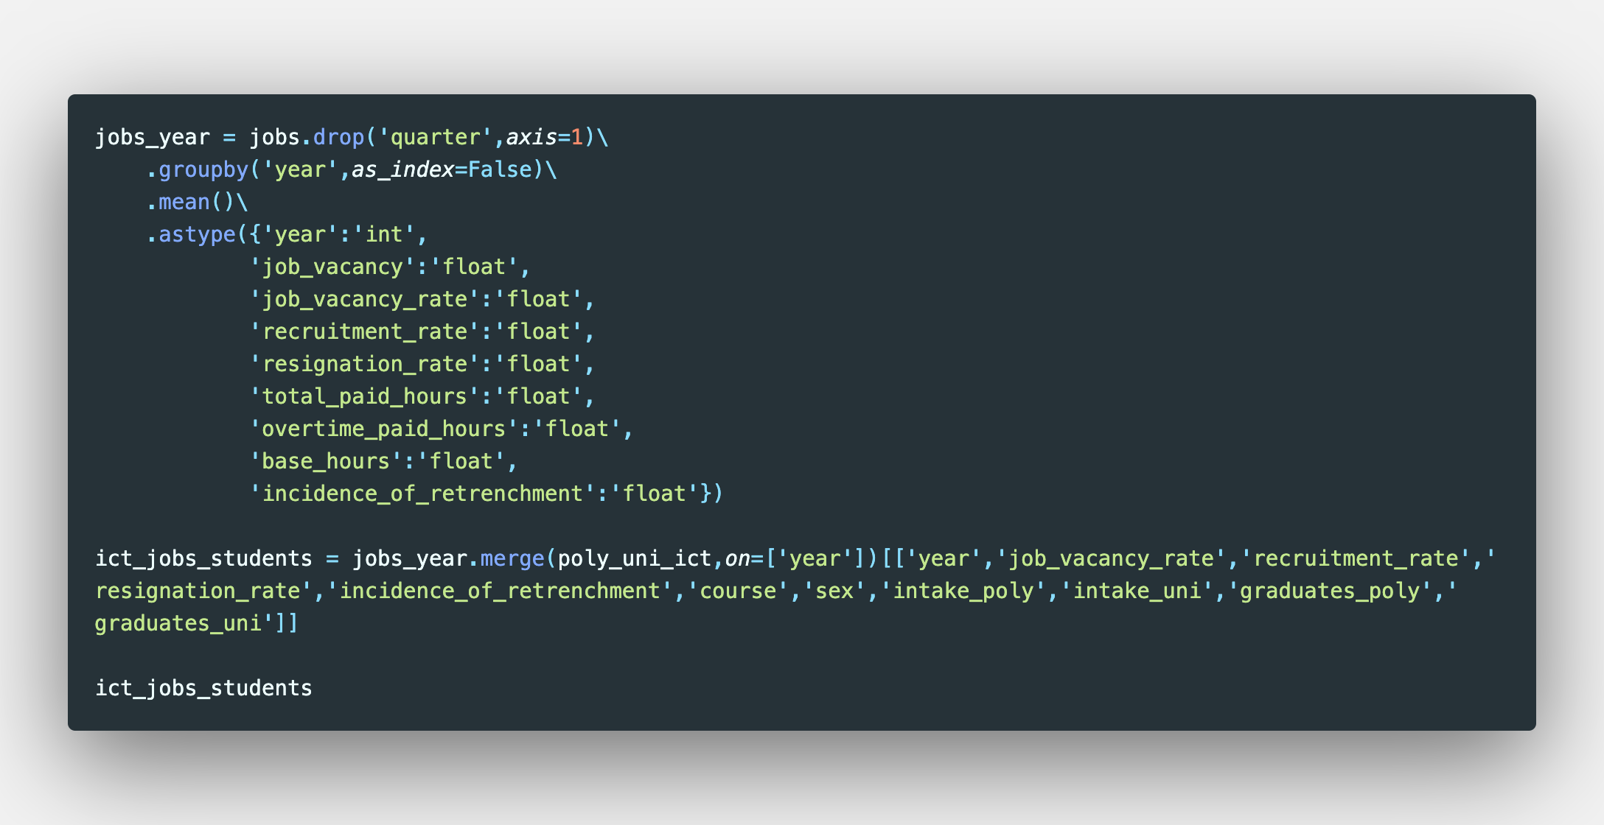
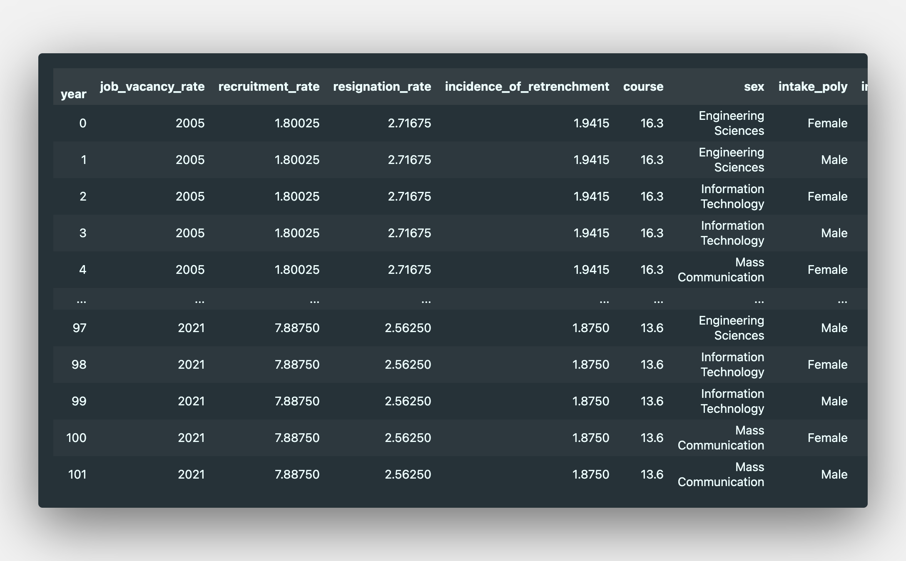
Datasets

Slide 5
Datasets

Slide 6
Datasets

Slide 7
Datasets

Slide 8
Datasets

Slide 9
Datasets

Slide 10
Datasets

Slide 11
Datasets

Slide 12
Datasets

Slide 13
Datasets

Slide 14
Datasets

Slide 15
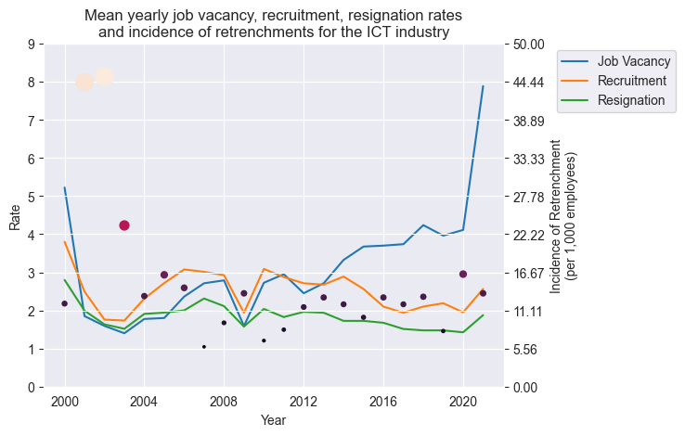
Mean yearly data

